Slide 1
Preparing for Deployment

Slide 2
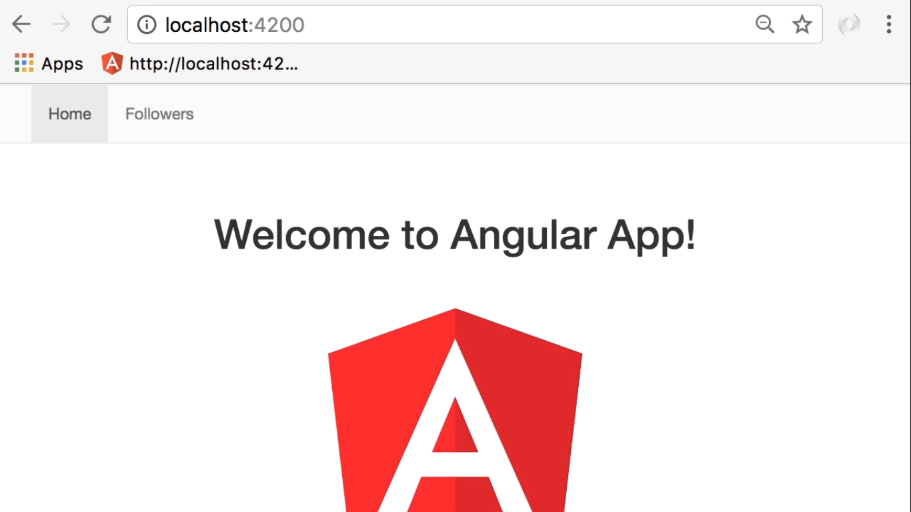

Slide 3
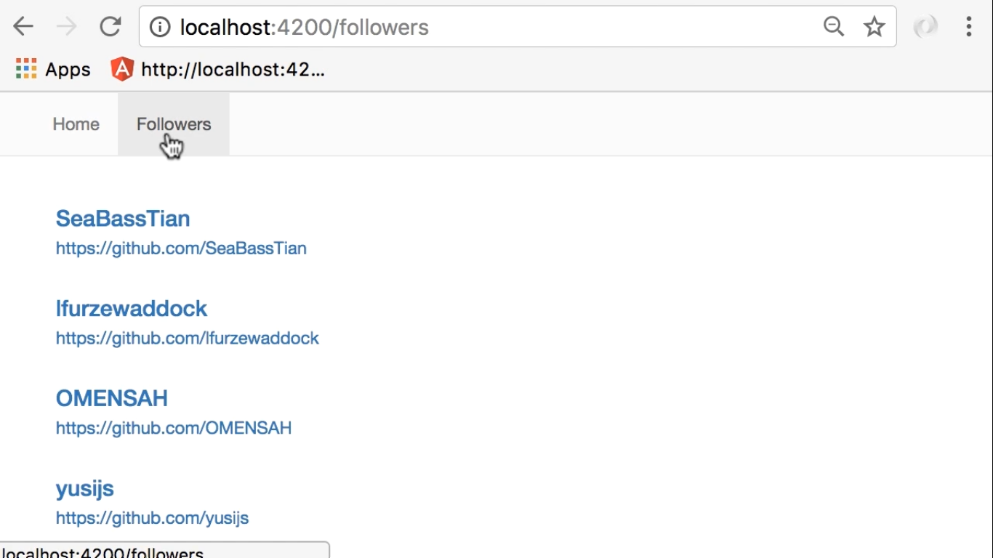

Slide 4
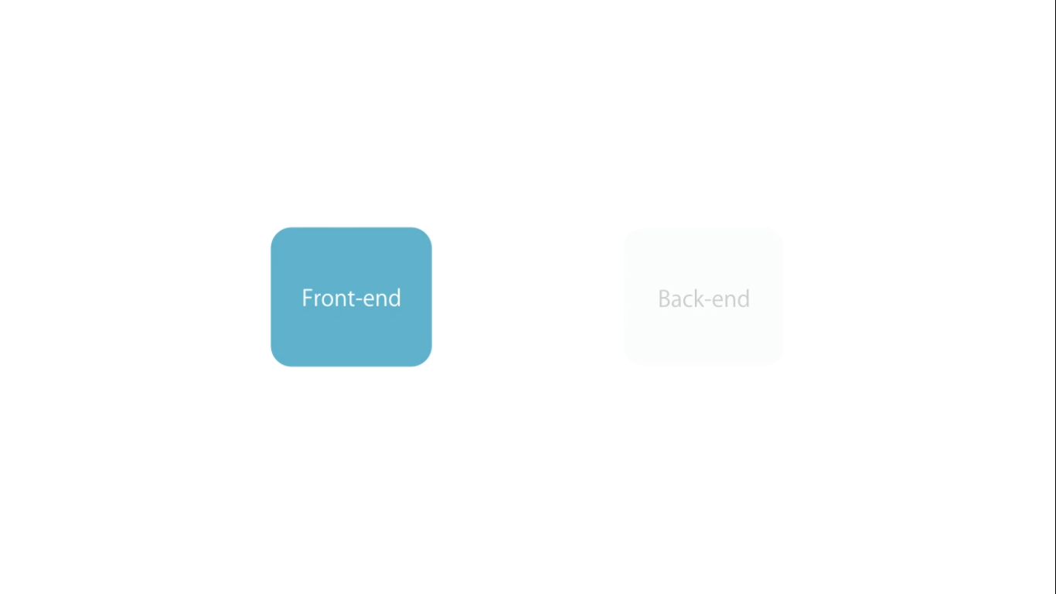
In this application we have only a front-end or
Back-end is a Github API which is provided by third party

Slide 5
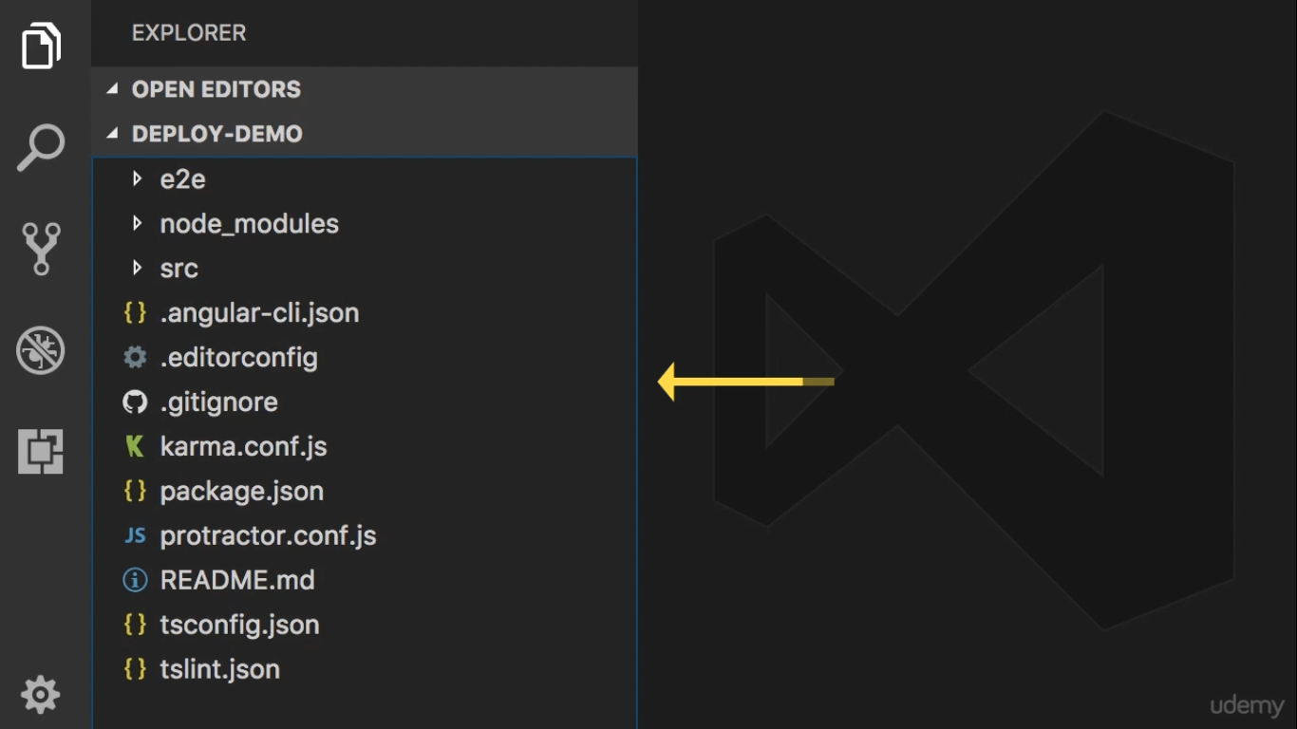
There is Two approach to deploy this angular app
The first one is
Copy all of entire application into production machine
And then run ng serve

Slide 6
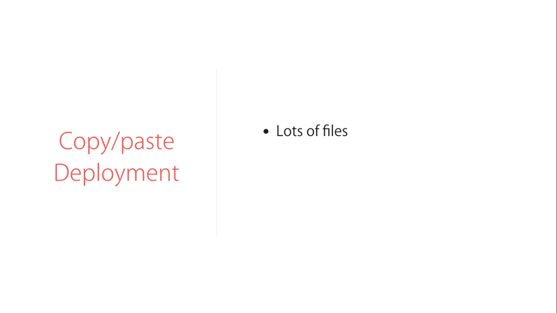

Slide 7
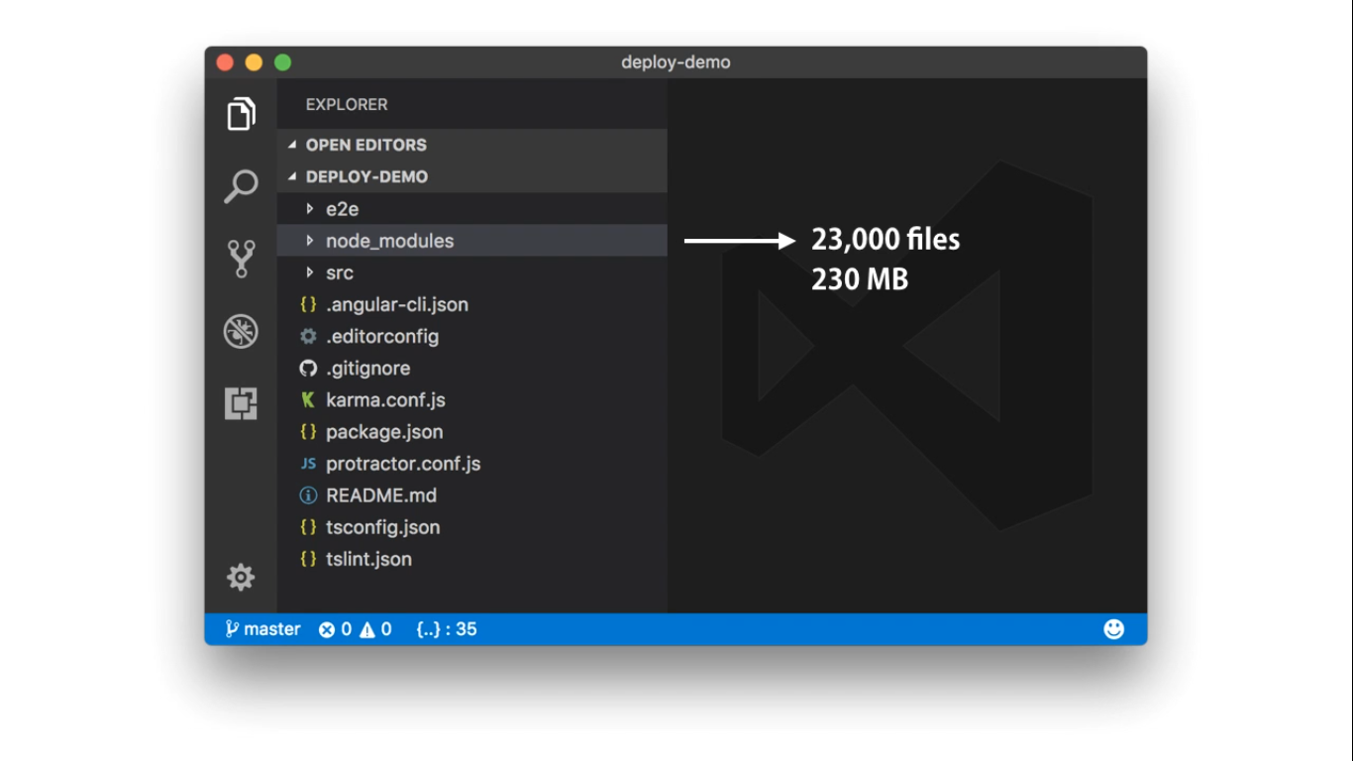

Slide 8
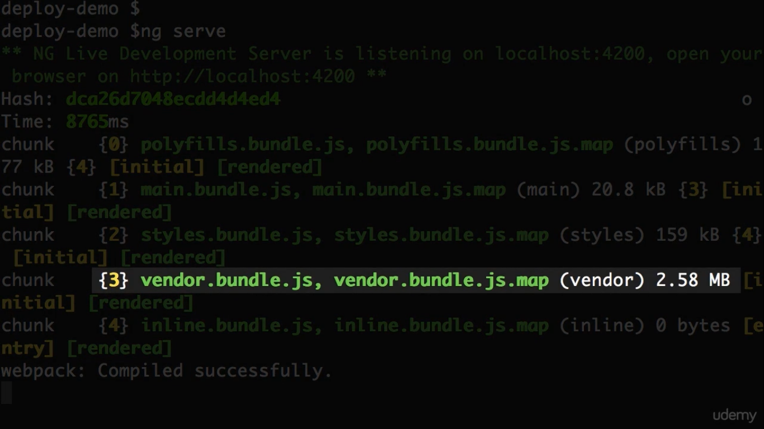

Slide 9
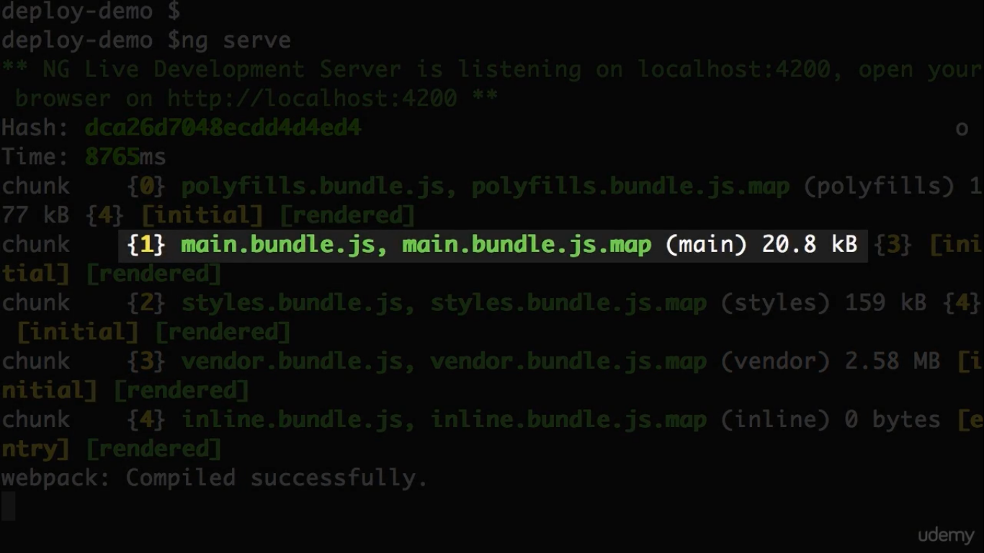

Slide 10
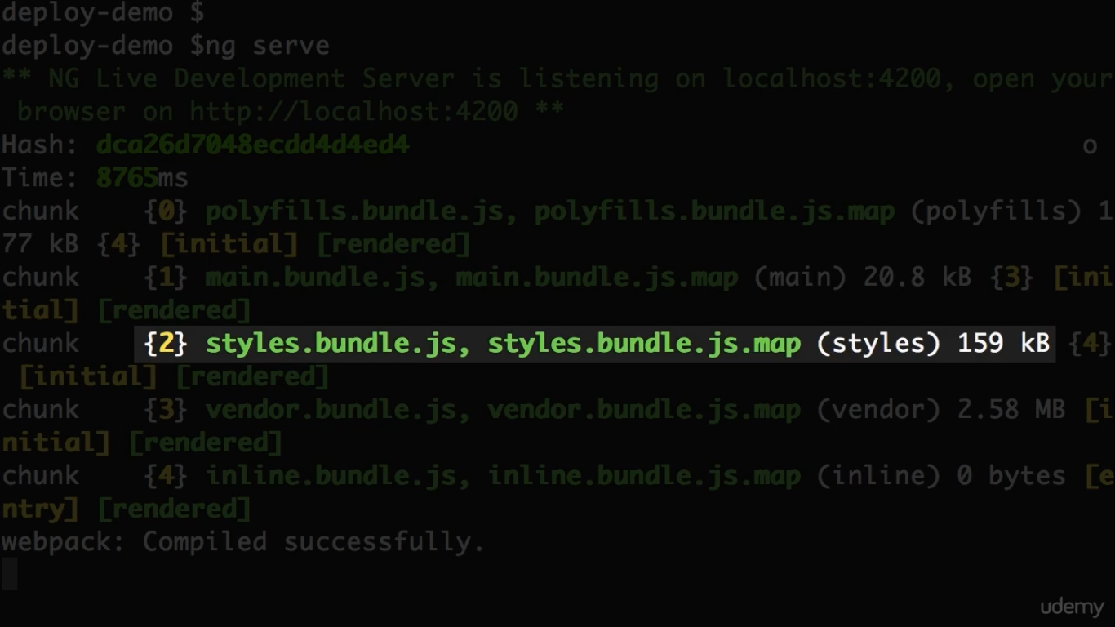

Slide 11
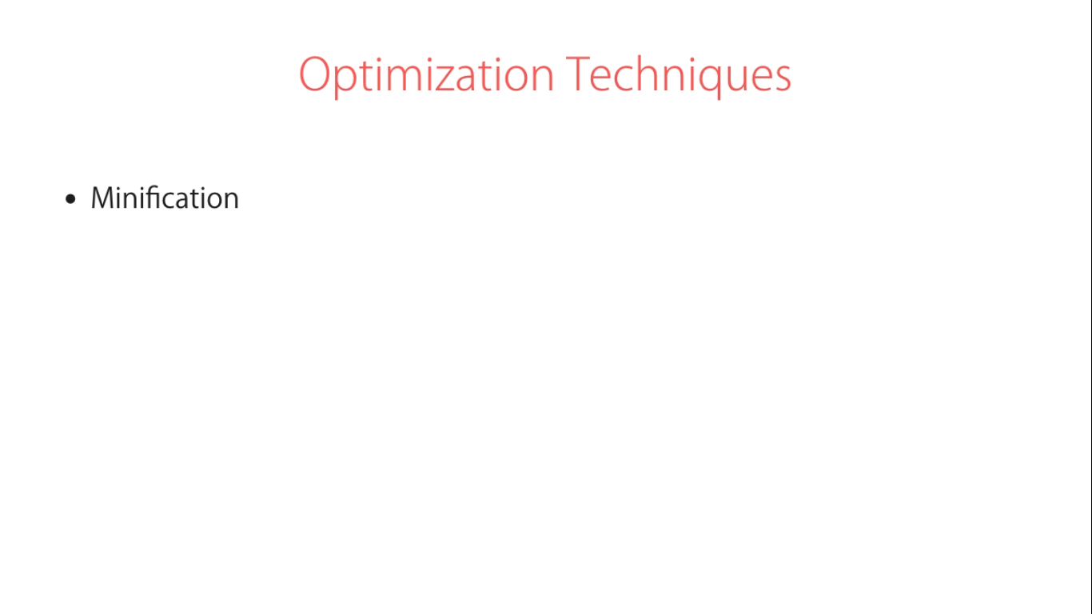
အရင္တုန္းက Optimization Technique ေတြေတာ့႐ွိတယ္ ဒါမယ့္ Angular အတြက္မဟုတ္ဘူး

Slide 12
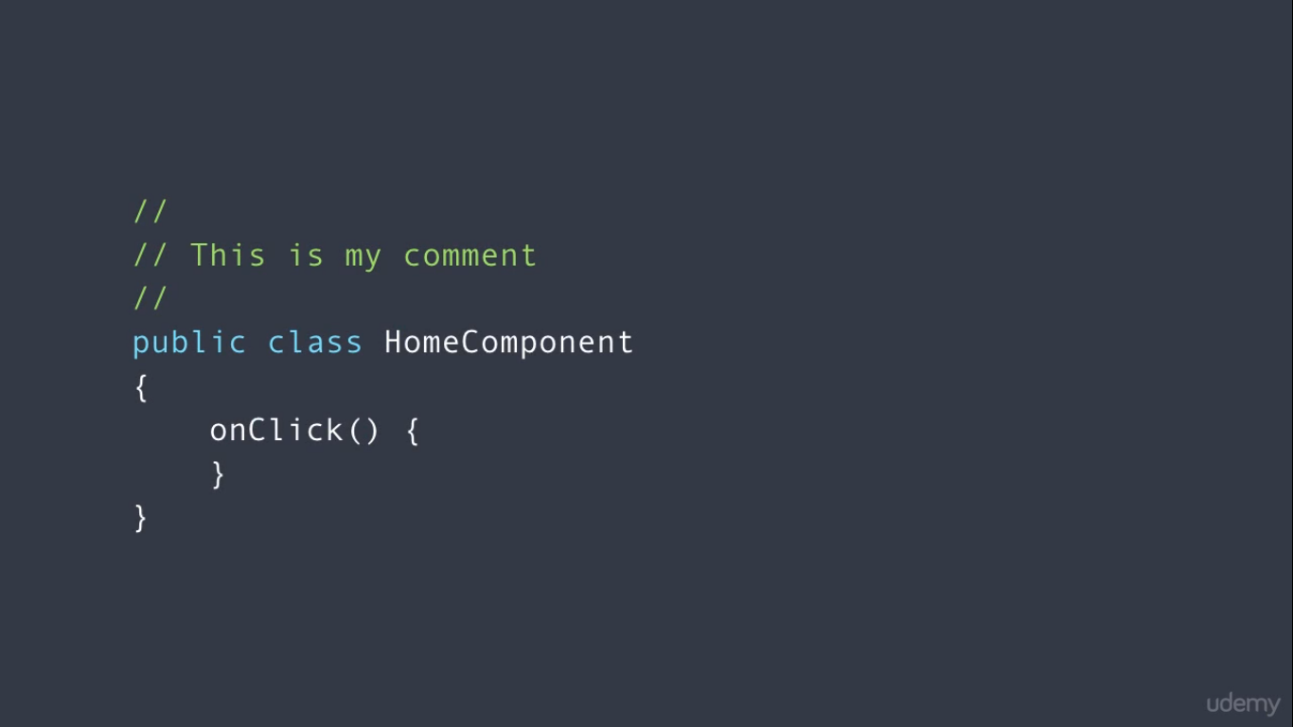

Slide 13
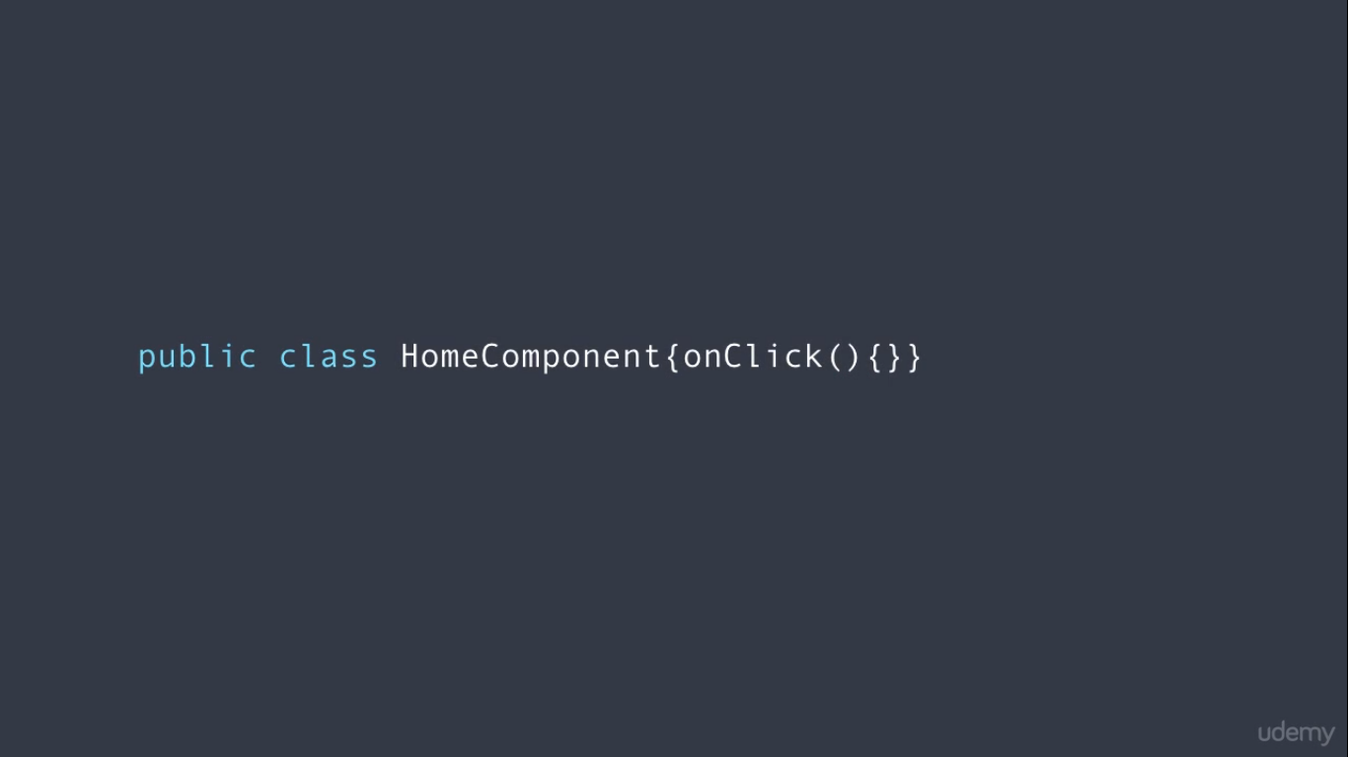
All the white spce are gone and this is minification

Slide 14
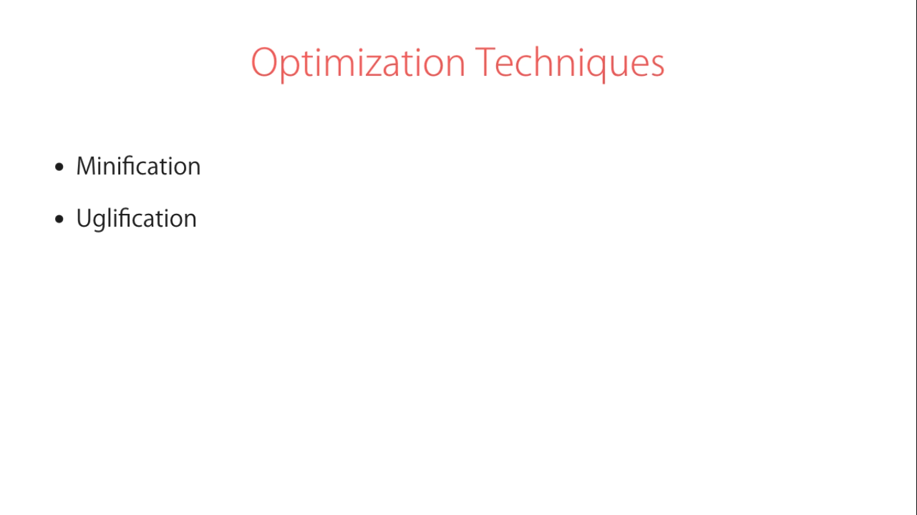

Slide 15


Slide 16
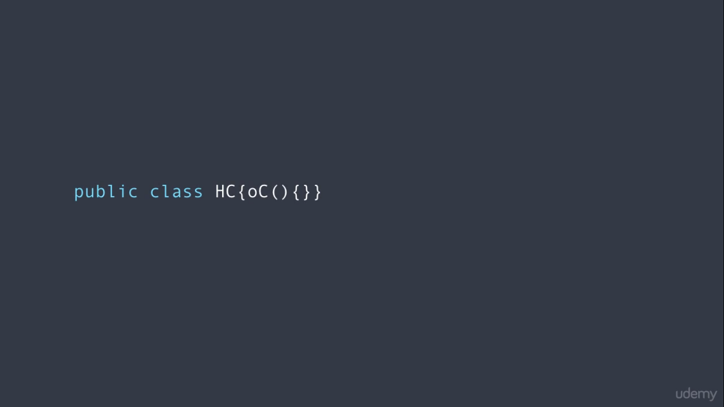
This is uglyfication

Slide 17
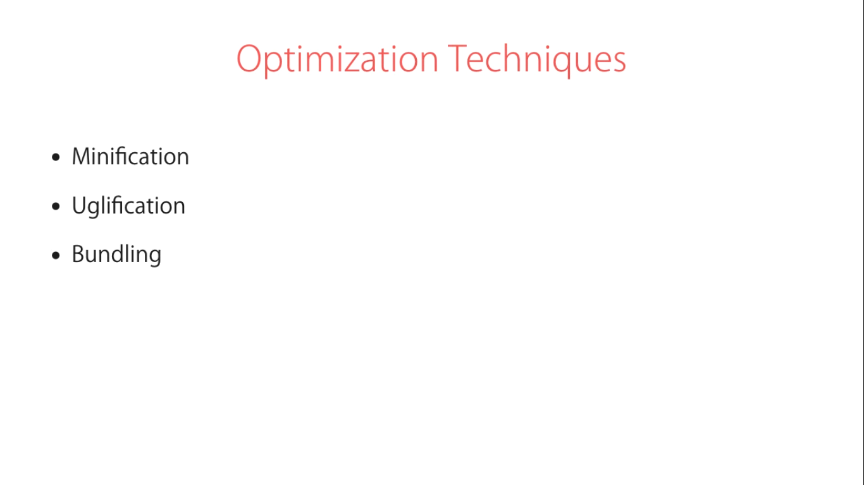

Slide 18
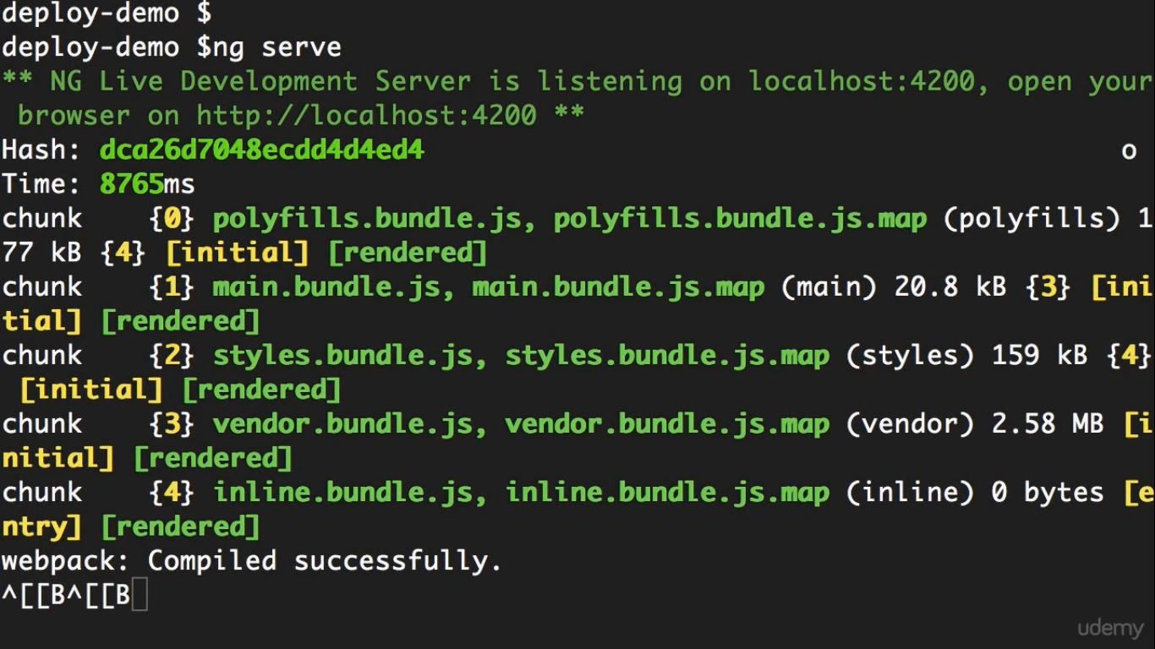

Slide 19
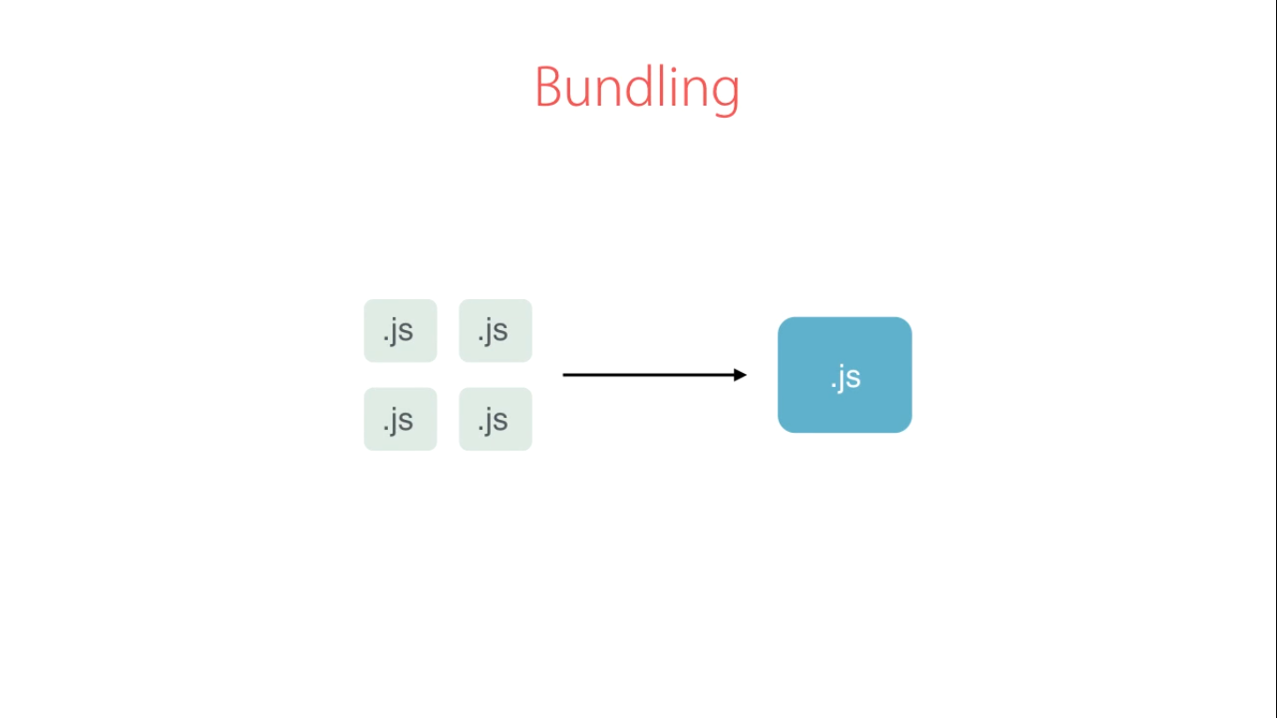
Bundle မလုပ္ထားဘူးဆိုရင္ ပံုမွန္ဆို http request ေတြအမ်ားႀကီး ရမယ္
Bundle လုပ္ထားတယ္ဆိုရင္ http request တစ္ခုပဲ
http request မ်ားျခင္းက website loading time ေႏွးေစတယ္

Slide 20
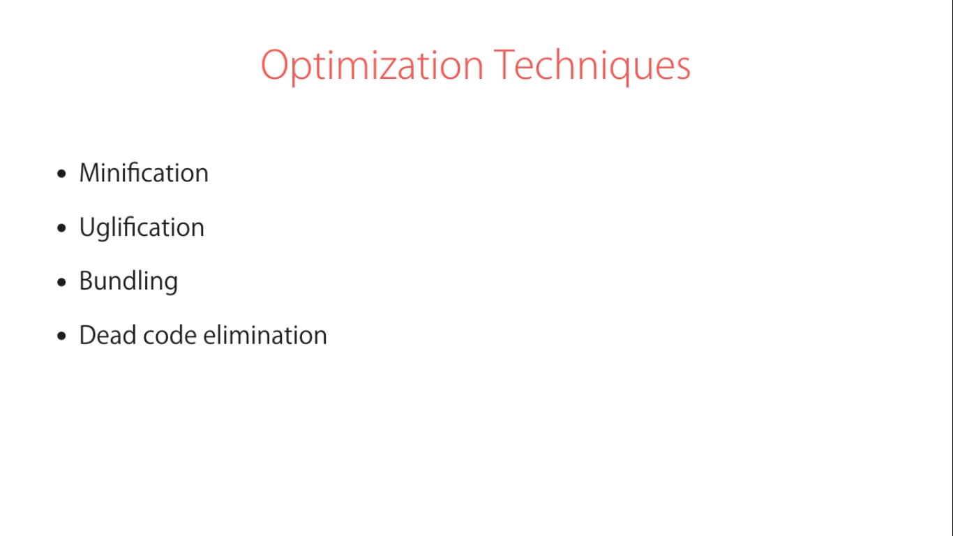

Slide 21
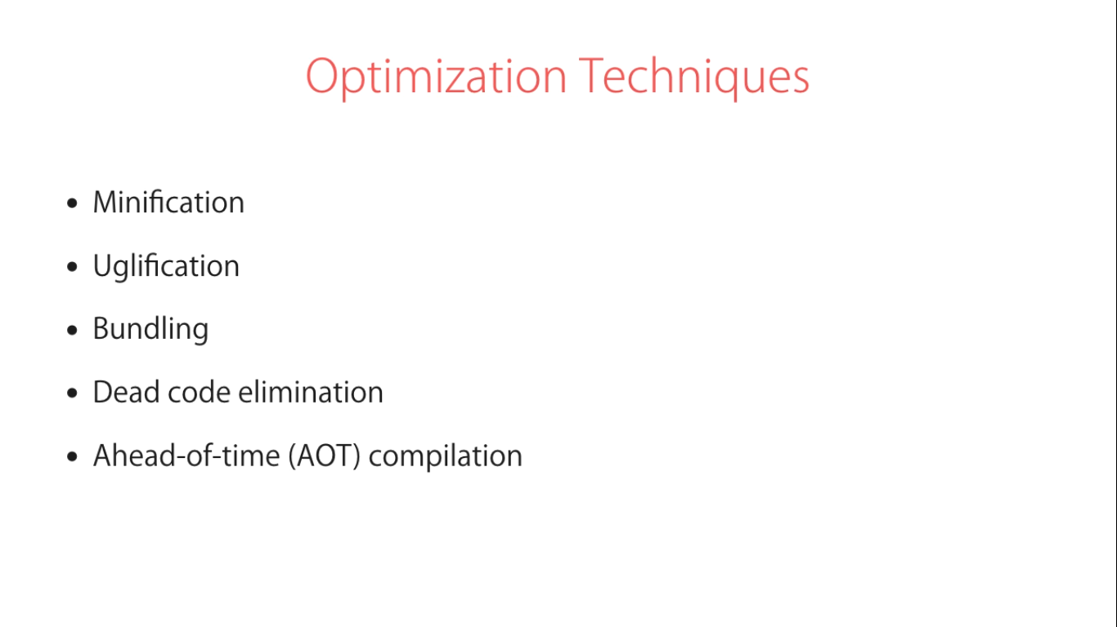

Slide 22
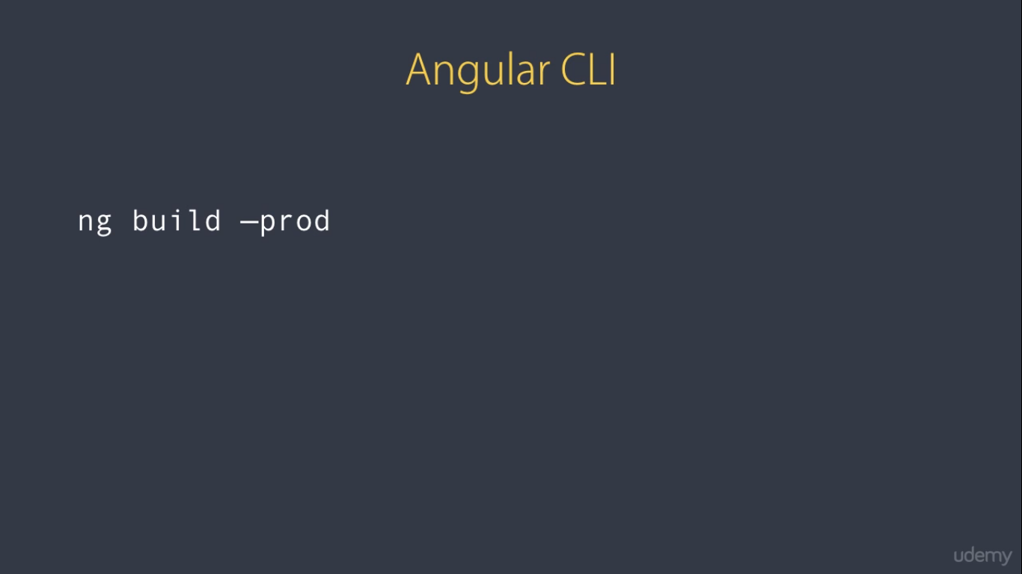
သတင္းေကာင္းက angular cli command က ေစာက Optimization Techniques ေတြအကုန္လံုးကို လုပ္ေပးႏိုင္တယ္

